Slide 1
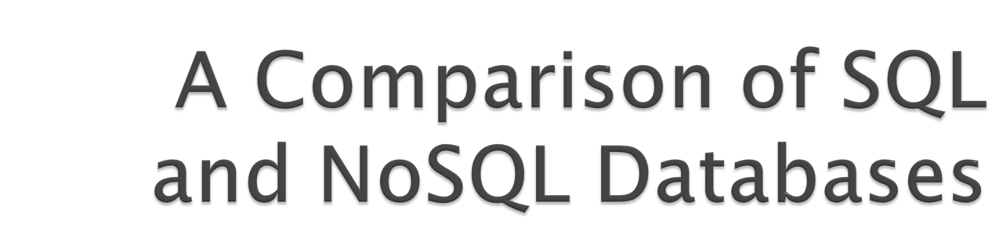

Slide 2

NoSQL databases (either no-SQL or Not Only SQL) are currently a hot topic in some parts of computing. In fact, one website lists over a hundred different NoSQL databases.
This presentation reviews the features common to the NoSQL databases and compares those features to the features and capabilities of SQL databases.
Metadata Open Forum

Slide 3

SQL Databases
  SQL Standard
  SQL Characteristics
  SQL Database Examples
NoSQL Databases
  NoSQL Defintion
  General Characteristics
  NoSQL Database Types
  NoSQL Database Examples
Metadata Open Forum

Slide 4

The following is a short, incomplete history of the SQL Standards – ISO/IEC 9075
1987 – Initial ISO/IEC Standard
1989 – Referential Integrity
1992 – SQL2
  1995 SQL/CLI (ODBC)
  1996 SQL/PSM – Procedural Language extensions
1999 – User Defined Types
2003 – SQL/XML
2008 – Expansions and corrections
2011 (or 2012) System Versioned and Application Time Period Tables
Metadata Open Forum

Slide 5

Data stored in columns and tables
Relationships represented by data
Data Manipulation Language
Data Definition Language
Transactions
Abstraction from physical layer
Metadata Open Forum

Slide 6

Applications specify what, not how
Query optimization engine
Physical layer can change without modifying applications
  Create indexes to support queries
  In Memory databases

Slide 7

Data manipulated with Select, Insert, Update, & Delete statements
  Select T1.Column1, T2.Column2 …
  From Table1, Table2 …
  Where T1.Column1 = T2.Column1 …
Data Aggregation
Compound statements
Functions and Procedures
Explicit transaction control
Metadata Open Forum

Slide 8

Schema defined at the start
Create Table (Column1 Datatype1, Column2 Datatype 2, …)
Constraints to define and enforce relationships
  Primary Key
  Foreign Key
  Etc.
Triggers to respond to Insert, Update , & Delete
Stored Modules
Alter …
Drop …
Security and Access Control
Metadata Open Forum

Slide 9

Atomic – All of the work in a transaction completes (commit) or none of it completes
Consistent – A transaction transforms the database from one consistent state to another consistent state. Consistency is defined in terms of constraints.
Isolated – The results of any changes made during a transaction are not visible until the transaction has committed.
Durable – The results of a committed transaction survive failures
Metadata Open Forum

Slide 10

Commercial
  IBM DB2
  Oracle RDMS
  Microsoft SQL Server
  Sybase SQL Anywhere
Open Source (with commercial options)
  MySQL
  Ingres
Significant portions of the
world’s economy use SQL databases!
Metadata Open Forum

Slide 11

From www.nosql-database.org:
  Next Generation Databases mostly addressing some of the points: being non-relational, distributed, open-source and horizontal scalable. The original intention has been modern web-scale databases. The movement began early 2009 and is growing rapidly. Often more characteristics apply as: schema-free, easy replication support, simple API, eventually consistent / BASE (not ACID), a huge data amount, and more.
Metadata Open Forum

Slide 12

http://www.nosql-database.org/ lists 122 NoSQL Databases
Cassandra
CouchDB
Hadoop & Hbase
MongoDB
StupidDB
Etc.
Metadata Open Forum

Slide 13

Large data volumes
  Google’s “big data”
Scalable replication and distribution
  Potentially thousands of machines
  Potentially distributed around the world
Queries need to return answers quickly
Mostly query, few updates
Asynchronous Inserts & Updates
Schema-less
ACID transaction properties are not needed – BASE
CAP Theorem
Open source development
Metadata Open Forum

Slide 14
Acronym contrived to be the opposite of ACID
Basically Available: This constraint states that the system does guarantee the availability of the data as regards CAP Theorem; there will be a response to any request. But, that response could still be ‘failure’ to obtain the requested data or the data may be in an inconsistent or changing state
Soft state: The state of the system could change over time, so even during times without input there may be changes going on due to ‘eventual consistency,’ thus the state of the system is always ‘soft.’
Eventual consistency: The system will eventually become consistent once it stops receiving input. The data will propagate to everywhere it should sooner or later, but the system will continue to receive input and is not checking the consistency of every transaction before it moves onto the next one. Werner Vogel’s article “Eventually Consistent – Revisited” covers this topic is much greater detail.
Characteristics
  Weak consistency – stale data OK
  Availability first
  Best effort
  Approximate answers OK
  Aggressive (optimistic)
  Simpler and faster
Metadata Open Forum

Slide 15

A distributed system can support only two of the following characteristics:
Consistency
Availability
Partition tolerance
The slides from Brewer’s July 2000 talk do not define these characteristics.
Metadata Open Forum

Slide 16

all nodes see the same data at the same time – Wikipedia
client perceives that a set of operations has occurred all at once – Pritchett
More like Atomic in ACID transaction properties
Metadata Open Forum

Slide 17

  node failures do not prevent survivors from continuing to operate – Wikipedia
Every operation must terminate in an intended response – Pritchett
Metadata Open Forum

Slide 18

  the system continues to operate despite arbitrary message loss – Wikipedia
Operations will complete, even if individual components are unavailable – Pritchett
Metadata Open Forum

Slide 19
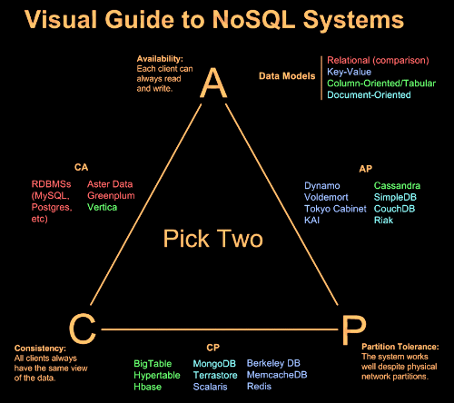
Metadata Open Forum

Slide 20

Discussing NoSQL databases is complicated because there are a variety of types:
Column Store – Each storage block contains data from only one column
Document Store – stores documents made up of tagged elements
Key-Value Store – Hash table of keys
Metadata Open Forum

Slide 21

XML Databases
Graph Databases
Codasyl Databases
Object Oriented Databases
Etc…
Will not address these today
Metadata Open Forum

Slide 22

Each storage block contains data from only one column
Example: Hadoop/Hbase
  http://hadoop.apache.org/
  Yahoo, Facebook
Example: Ingres VectorWise
  Column Store integrated with an SQL database
  http://www.ingres.com/products/vectorwise
Metadata Open Forum

Slide 23
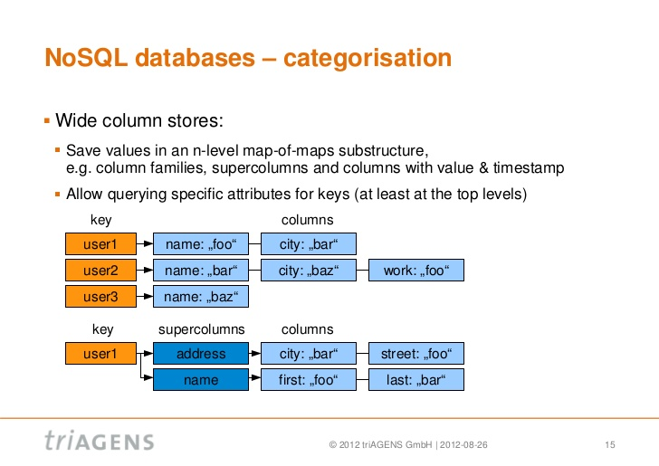

Metadata Open Forum

Slide 24

More efficient than row (or document) store if:
  Multiple row/record/documents are inserted at the same time so updates of column blocks can be aggregated
  Retrievals access only some of the columns in a row/record/document
Metadata Open Forum

Slide 25
Metadata Open Forum

Slide 26

Example: CouchDB
  http://couchdb.apache.org/
  BBC
Example: MongoDB
  http://www.mongodb.org/
  Foursquare, Shutterfly
JSON – JavaScript Object Notation
Metadata Open Forum

Slide 27
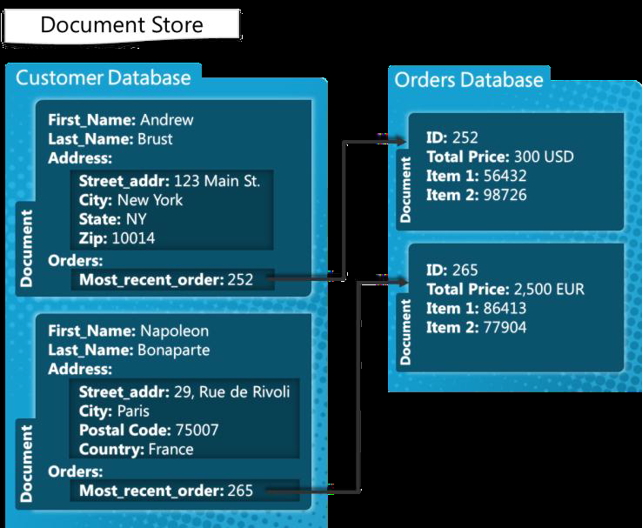
Metadata Open Forum

Slide 28

{
"_id": "guid goes here",
"_rev": "314159",
"type": "abstract",
"author": "Keith W. Hare"
"title": "SQL Standard and NoSQL Databases",
"body": "NoSQL databases (either no-SQL or Not Only SQL)
are currently a hot topic in some parts of
computing.",
"creation_timestamp": "2011/05/10 13:30:00 +0004"
}
Metadata Open Forum

Slide 29

"_id"
  GUID – Global Unique Identifier
  Passed in or generated by CouchDB
"_rev"
  Revision number
  Versioning mechanism
"type", "author", "title", etc.
  Arbitrary tags
  Schema-less
  Could be validated after the fact by user-written routine
Metadata Open Forum

Slide 30

Hash tables of Keys
Values stored with Keys
Fast access to small data values
Example – Project-Voldemort
  http://www.project-voldemort.com/
  Linkedin
Example – MemCacheDB
  http://memcachedb.org/
  Backend storage is Berkeley-DB
Metadata Open Forum

Slide 31
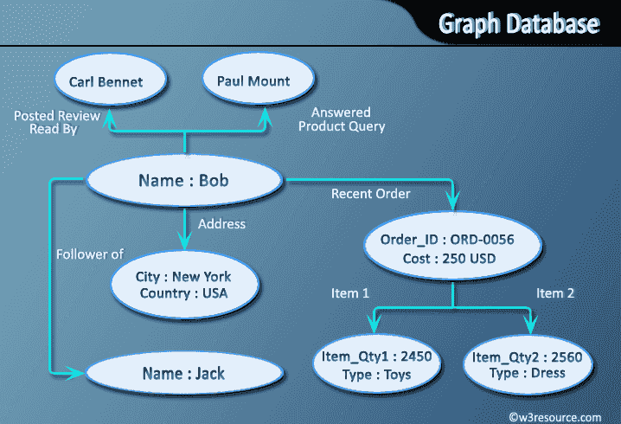
Metadata Open Forum

Slide 32

Technique for indexing and searching large data volumes
Two Phases, Map and Reduce
  Map
    Extract sets of Key-Value pairs from underlying data
    Potentially in Parallel on multiple machines
  Reduce
    Merge and sort sets of Key-Value pairs
    Results may be useful for other searches
Metadata Open Forum

Slide 33
Map Reduce techniques differ across products
Implemented by application developers, not by underlying software
Metadata Open Forum

Slide 34

Google granted US Patent 7,650,331, January 2010
  System and method for efficient large-scale data processing
  A large-scale data processing system and method includes one or more application-independent map modules configured to read input data and to apply at least one application-specific map operation to the input data to produce intermediate data values, wherein the map operation is automatically parallelized across multiple processors in the parallel processing environment. A plurality of intermediate data structures are used to store the intermediate data values. One or more application-independent reduce modules are configured to retrieve the intermediate data values and to apply at least one application-specific reduce operation to the intermediate data values to provide output data.
Metadata Open Forum

Slide 35

Syntax varies
  HTML
  Java Script
  Etc.
Asynchronous – Inserts and updates do not wait for confirmation
Versioned
Optimistic Concurrency
Metadata Open Forum

Slide 36

Syntax Varies
  No set-based query language
  Procedural program languages such as Java, C, etc.
Application specifies retrieval path
No query optimizer
Quick answer is important
May not be a single “right” answer
Metadata Open Forum

Slide 37

Small upfront software costs
Suitable for large scale distribution on commodity hardware
Metadata Open Forum

Slide 38

NoSQL databases reject:
  Overhead of ACID transactions
  “Complexity” of SQL
  Burden of up-front schema design
  Declarative query expression
  Yesterday’s technology
Programmer responsible for
  Step-by-step procedural language
  Navigating access path
Metadata Open Forum

